Slide 2
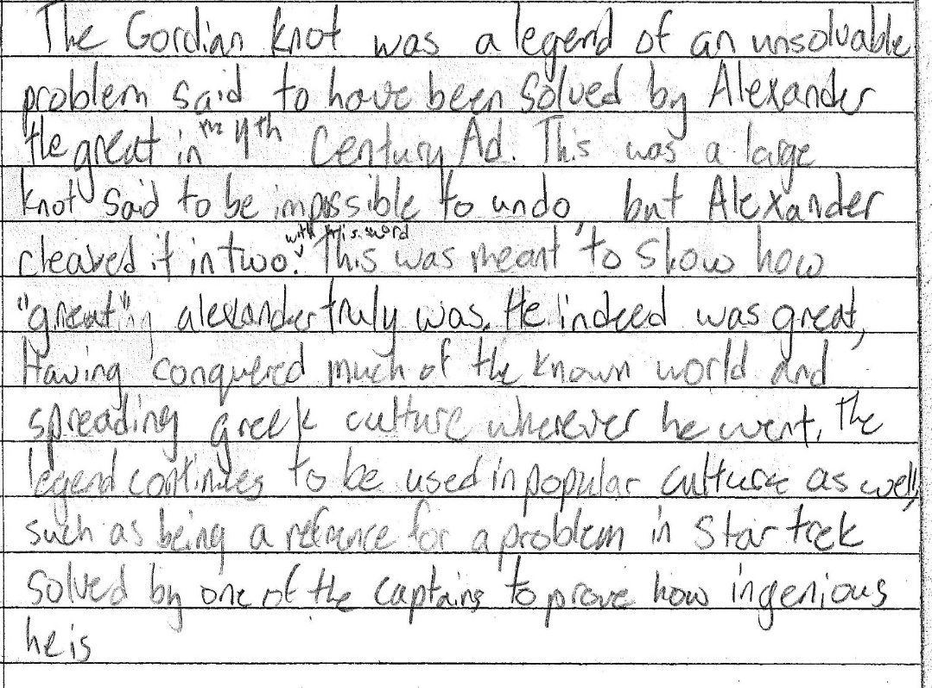
The Gordian Knot was a legend of an unsolvable problem said to have been solved by Alexander the Great in the 4th century. This was a large knot said to be impossible to undo, but Alexander cleaved it in two with his sword. This was meant to show how great Alexander truly was. He indeed was great, having conquered much of the known world and spreading Greek culture wherever he went. The legend continues to be used in popular culture was well, such as being a reference for a problem in Star Trek solved by one of the captains to prove how ingenious he his.
Excellent Example: Historically accurate, comprehensive, detailed, specific, and speaks to the larger significance of Alexander the Great as laid out in lecture.
Complete Credit (8 points)

Slide 3
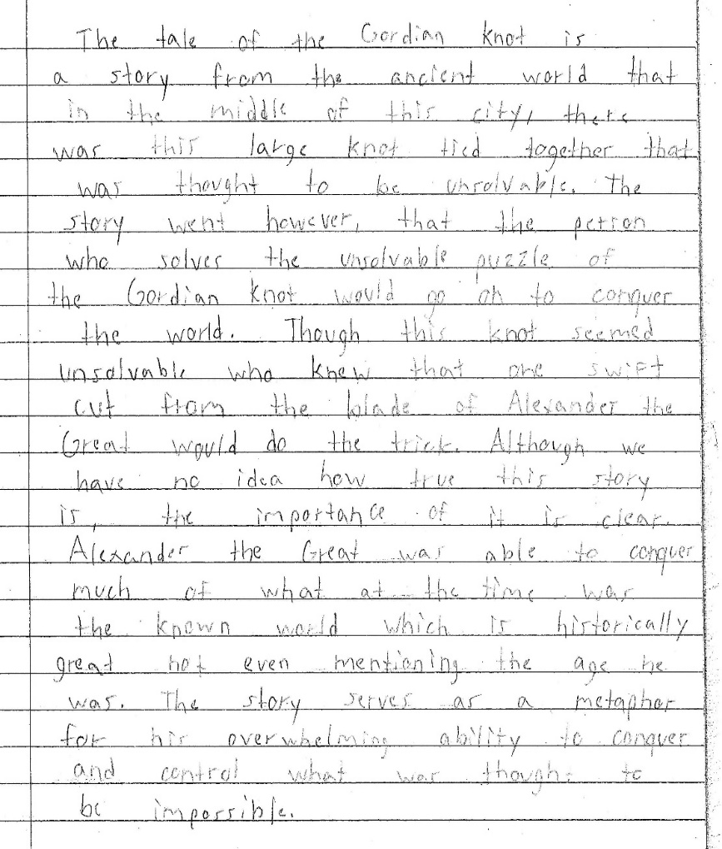
The tale of the Gordian Knot is a story from the ancient world that in the middle of this city, there was this large knot tied together that was thought to be unsolvable. The story went however, that the person who solves the unsolvable puzzle of the Gordian knot would go on to conquer the world. Though this knot seemed unsolvable who knew that one swift cut from the blade of Alexander the Great would do the trick. Although we have no idea how true this story is, the importance of it is clear. Alexander the Great was able to conquer much of what at the time was the known world which is historically great not even mentioning the age he was. The story serves as a metaphor for his overwhelming ability to conquer and control what was thought to be impossible.
Medium Example: The student has a good sense of the story and its significance as a metaphor for Alexander’s genius, but does not provide larger historical details or context (e.g., when, where, etc.)
Partial Credit (5-6 points)

Slide 4
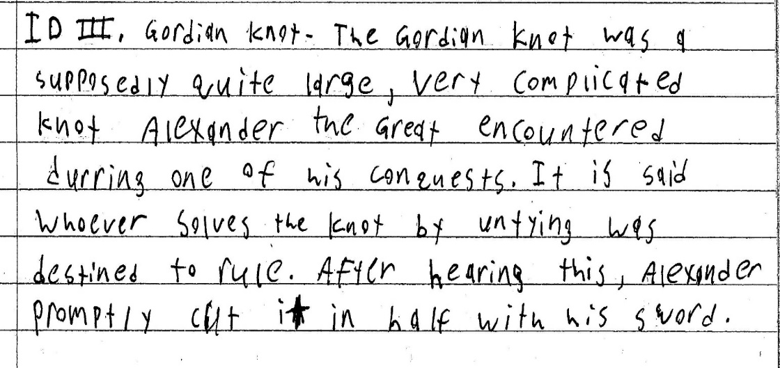
The Gordian Knot was a supposedly quite large, very complicated knot Alexander the Great encountered during one of his conquests. It is said whoever solves the knot by untying was destined to rule. After hearing this, Alexander promptly cut it in half with his sword.
Medium Example: Again, the student has a sense of the ID, but the response is lacking historical details and context and does not speak to any larger points from lecture about its significance.
Partial Credit (4-5 points)

Slide 5
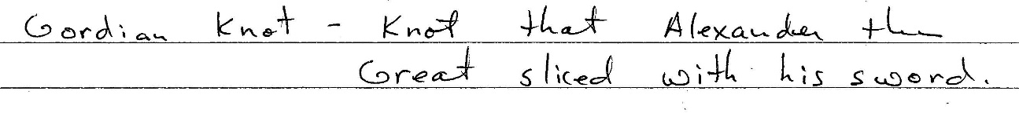
Knot that Alexander the Great sliced with his sword.
Poor Example: While what the student writes is technically accurate, the response is not comprehensive, detailed, or specific, nor does it speak to any larger points from lecture about its significance.
Minimal Credit (1-2 points)

Slide 6
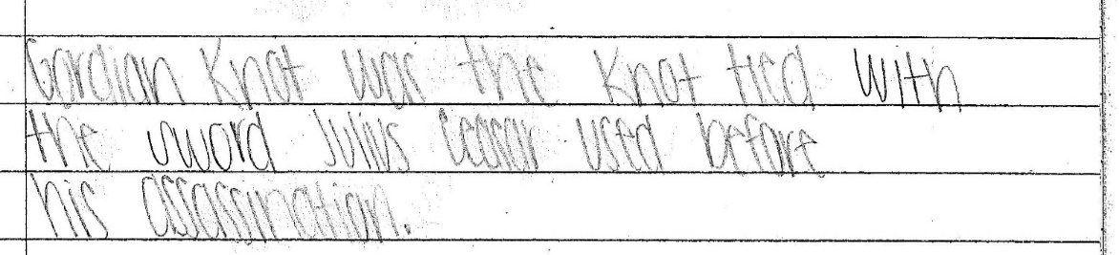
Gordian Knot was the knot tied with the sword Julius Caesar used before his assassination.
Poor Example: The student knows that the story involves a sword . . . but is mixing up the term with material from other lectures (e.g., Julius Caesar) and otherwise at a loss to provide any information that is relevant.
No Credit

